Slide 1

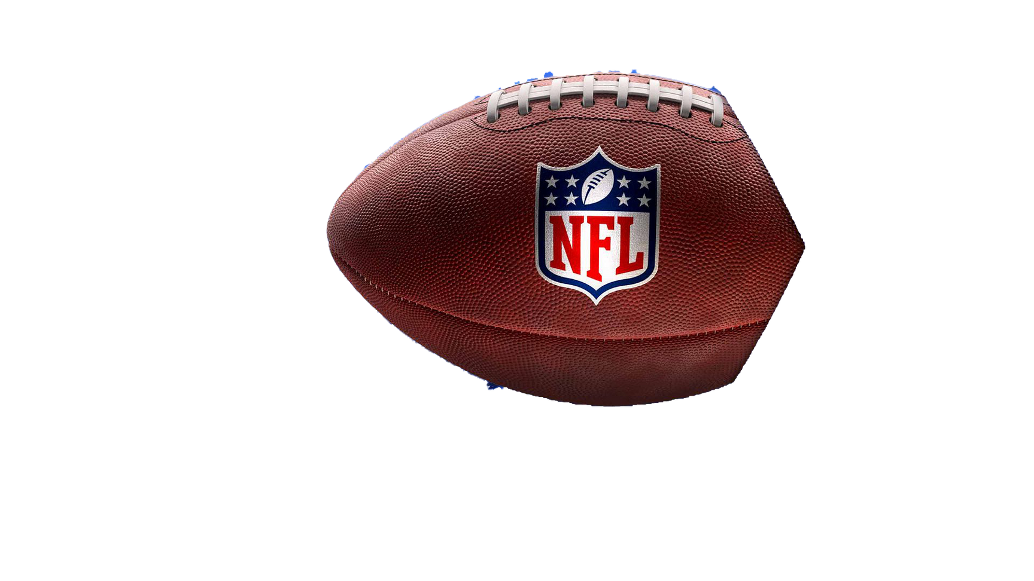
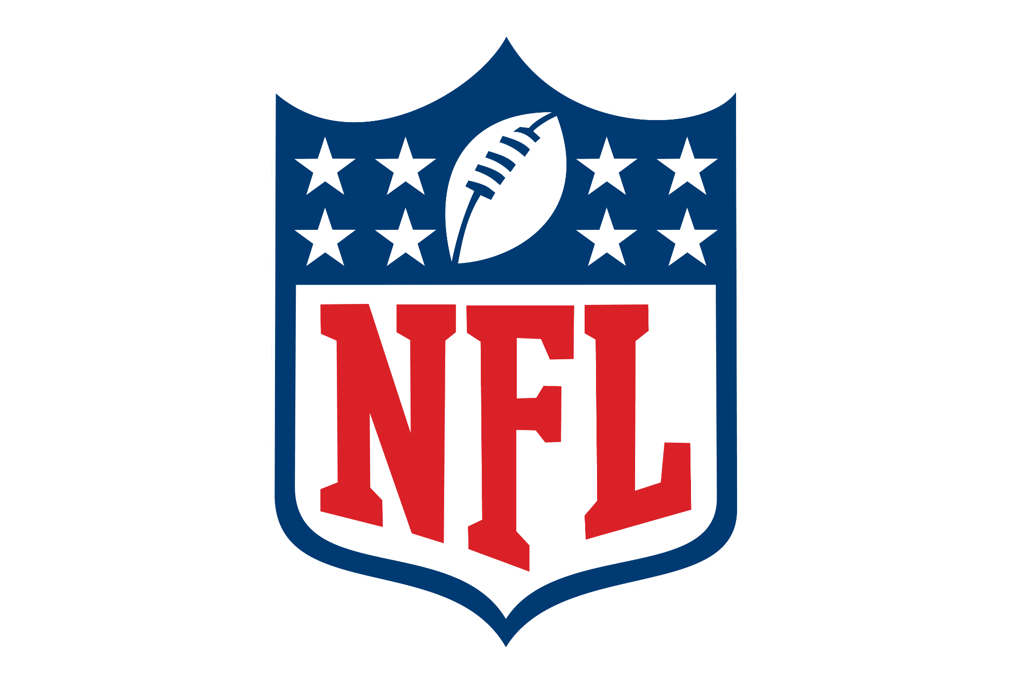
IMPACTS OF SOCIAL MEDIA ON DIRECT SALES
ACROSS THE NFL
How the NFL can utilize a database to positively influence social media marketing strategies and directly increase ticket and merchandise sales.
Presented Live by Group 2:
Diana Kim, Justin Mejia, Alyssa Miller, Pearson Roberts,
Matthew Rutigliano, and Samarth Tuli
BMSO 601
Database Presentation
1

Slide 2
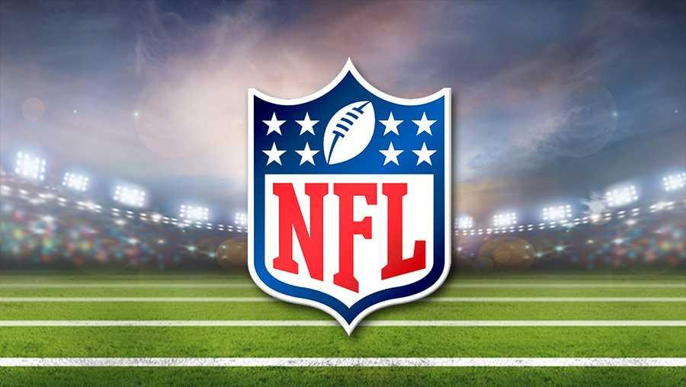
PRESENTATION OVERVIEW
01
02
03
Mission Statement
Mission Objectives
Business Rules
04
05
06
Entity Relationship Diagram
Queries
Tableau & Next Steps
Group 2 - BMSO 601 Term Group Project
2

Slide 3

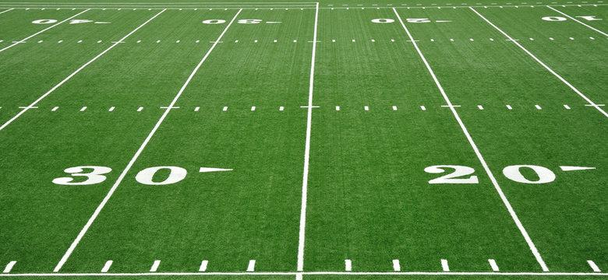
MISSION STATEMENT
The National Football League (NFL) database aims to track social media engagement, uncover insights to drive targeted marketing strategies, and, as a result, increase sales for both the league and individual teams.
Group 2 - BMSO 601 Term Group Project
3

Slide 4

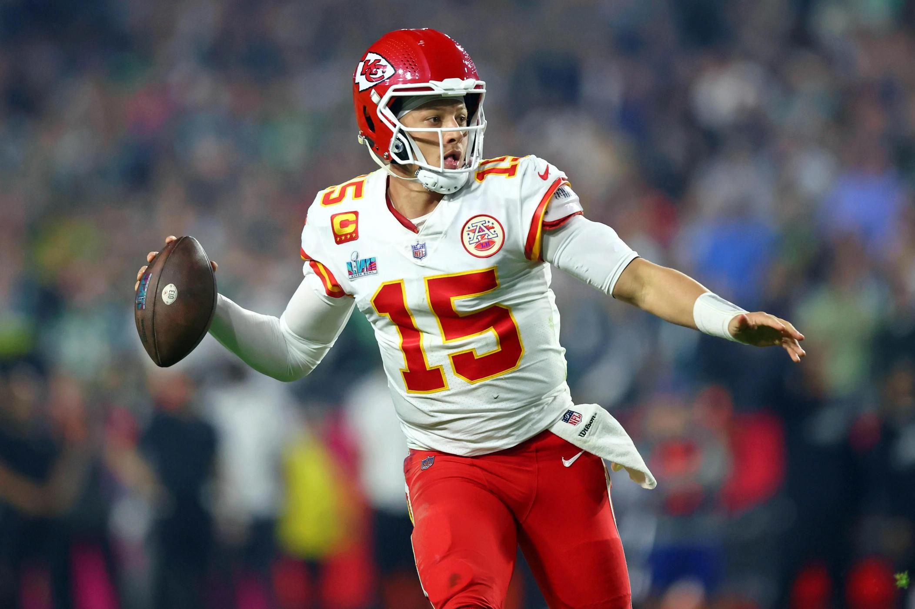
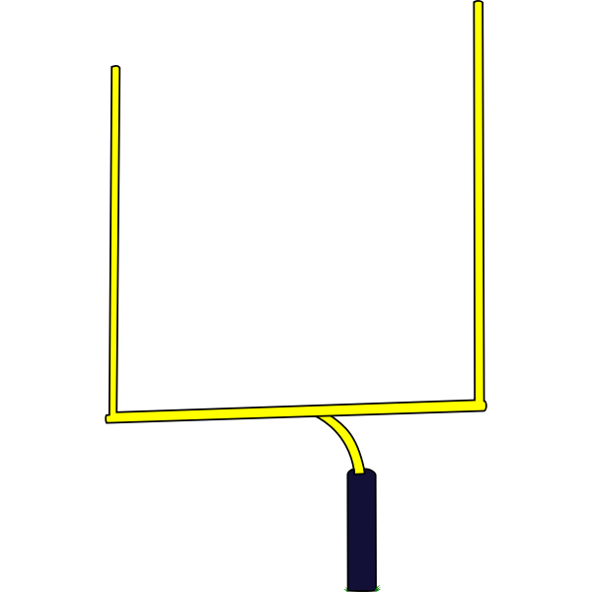
MISSION OBJECTIVES
What specific sales, marketing, and social media questions can the NFL answer though the use of this new database?
Group 2 - BMSO 601 Term Group Project
4

Slide 5
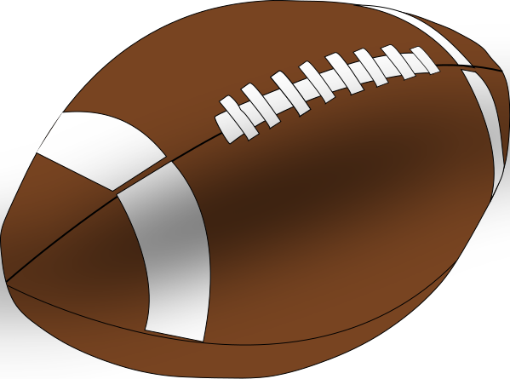
MISSION OBJECTIVES
Use social media account data to measure participation via engagement metrics.
1
To evaluate social media engagements to examine how they correlate to event ticket sales.
2
To evaluate social media engagements to examine how they correlate to event ticket sales..
To evaluate social media engagements to examine how they correlate to merchandise sales.
3
To evaluate social media engagements to examine how they correlate to merchandise sales.
Objective 3
4
Monitor the follower and engagement metrics of NFL athletes and teams on their social media accounts to identify benchmarks and opportunities for marketing strategies.
Group 2 - BMSO 601 Term Group Project
5

Slide 6
MISSION OBJECTIVES
To evaluate athlete rank and demographic data to examine if both correlate to fan participation and team sales.
5
To evaluate coach ranking and demographic data to examine how they correlate to fan participation and team sales.
To evaluate social media engagements to examine how they correlate to event ticket sales.
6
To evaluate social media engagements to examine how they correlate to merchandise sales.
7
To evaluate how current social media marketing efforts from teams are influencing female merchandise sales.
Objective 3
Maintain accurate and current data about NFL teams, athletes, coaches, & industry social media accounts and sales to preserve data integrity within a centralized database.
8
Group 2 - BMSO 601 Term Group Project
6

Slide 7

BUSINESS RULES
01
A team owns at most one verified social media account and a social media account is owned by one team.
02
A coach owns at most one verified social media account and a social media account is owned by one coach.
03
An athlete owns at most one verified social media account and a social media account is owned by one athlete.
06
A coach manages one team and a team is managed by one coach..
04
A verified social media account publishes zero or many posts but a post is published by only one verified social media account.
07
A product type must be either a merchandise item or ticket.
05
An athlete is registered to one team, but a team registers one or many athletes.
08
A team is associated with zero or many sales but a sale has one team associated with it.
09
A sale includes one product but a product is included in zero or many sales.
Group 2 - BMSO 601 Term Group Project
7
Notes:
Diana- 1 minute

Slide 8

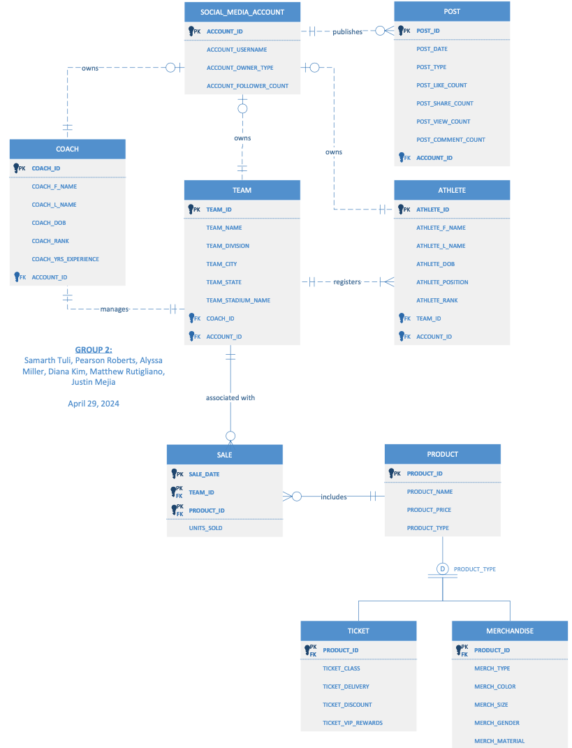

Entity-
Relationship (ER) Diagram
(full view)
Group 2 - BMSO 601 Term Group Project
8
Notes:
Communicating most important points. Diana - 1.5 min

Slide 9
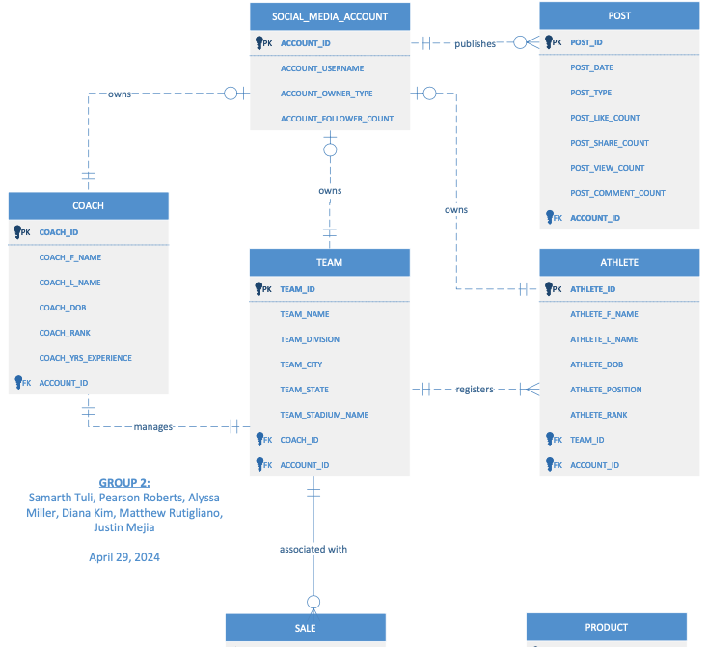
ER Diagram
(top half view)
Group 2 - BMSO 601 Term Group Project
9
Notes:
Communicating most important points. Diana - 1.5 min

Slide 10
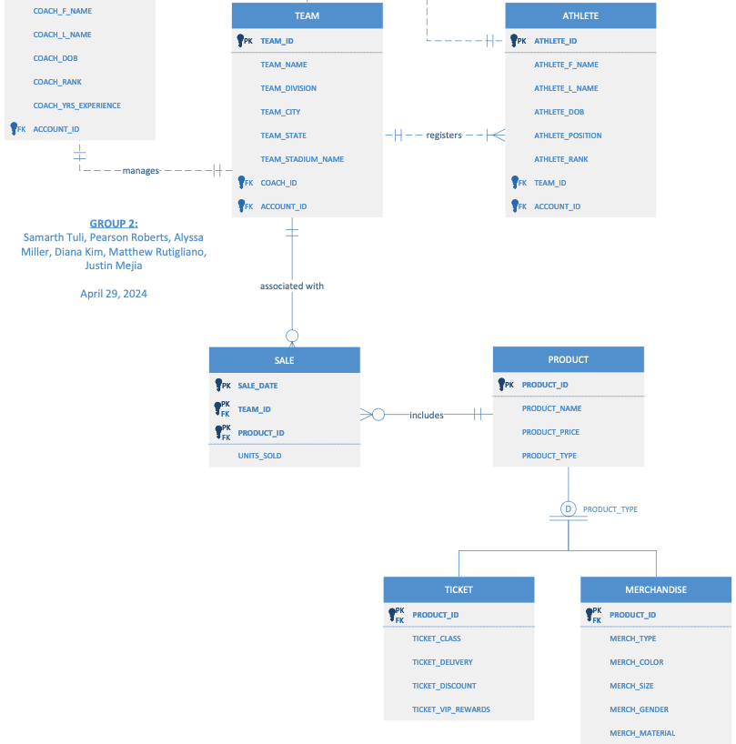
ER Diagram
(bottom half view)
Group 2 - BMSO 601 Term Group Project
10
Notes:
Communicating most important points.

Slide 11
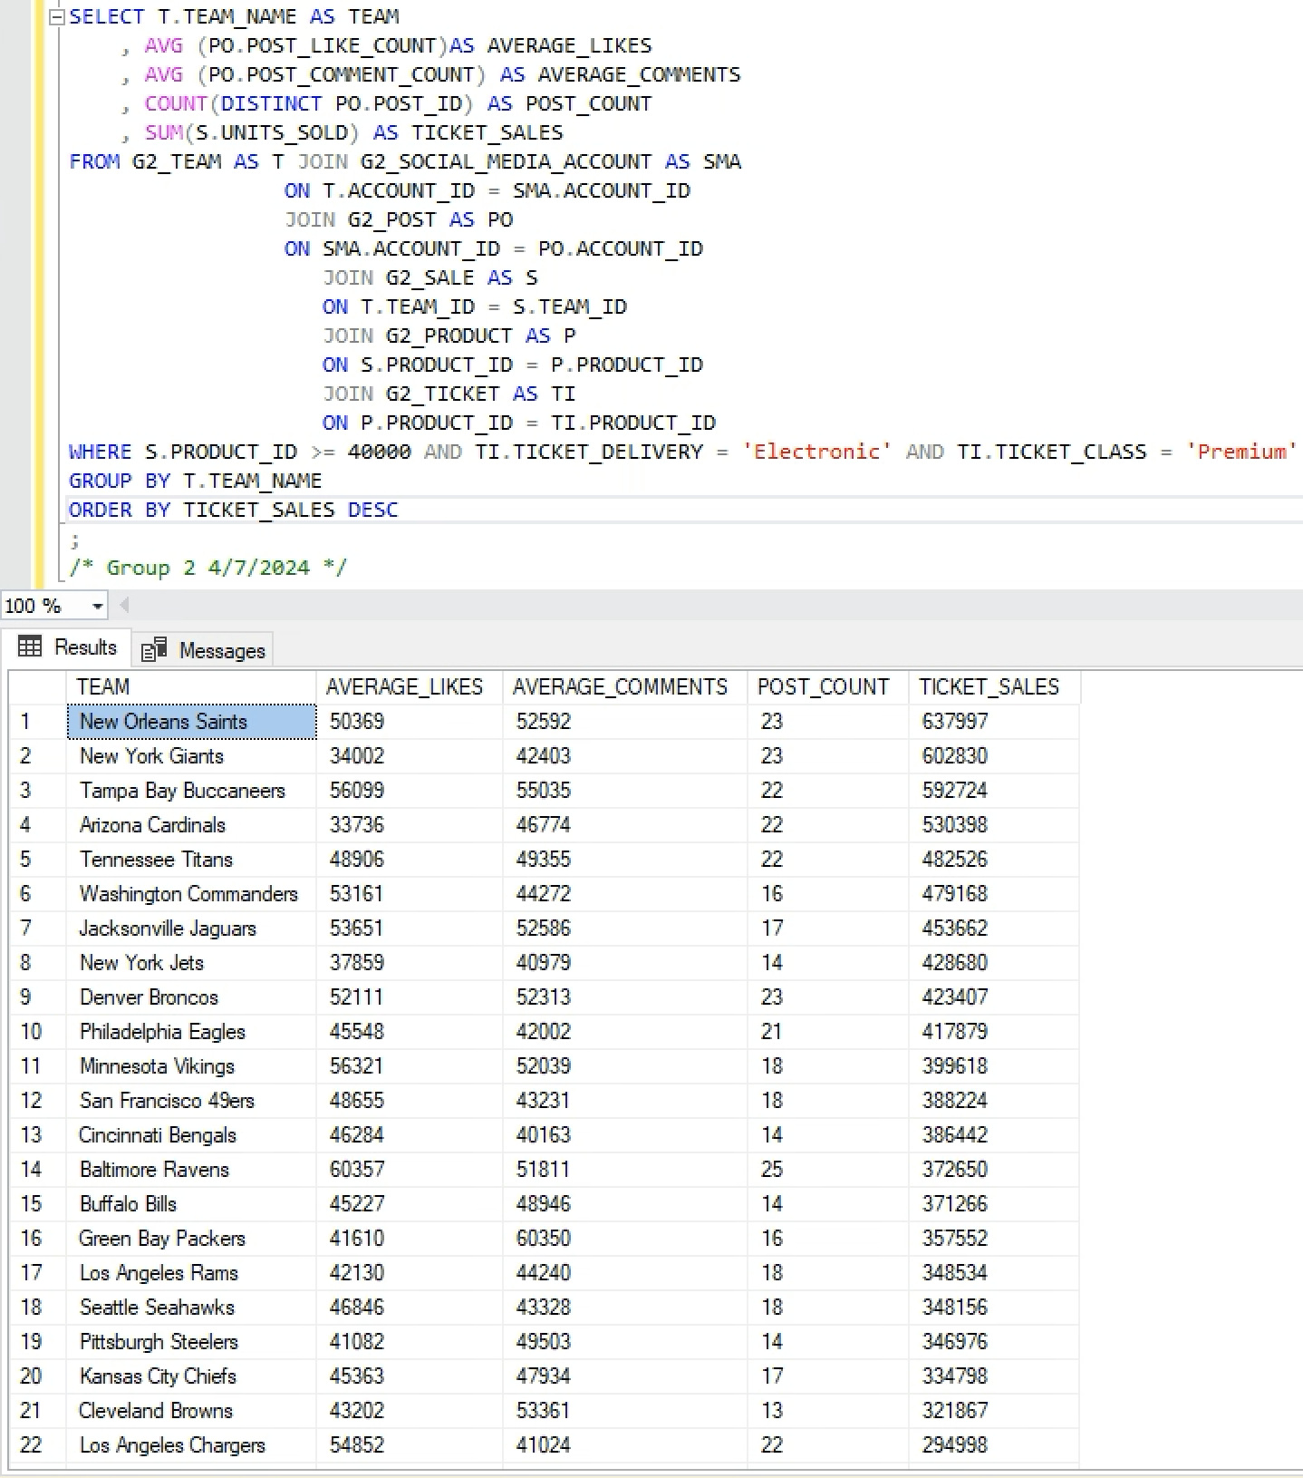
Social Media Impact on Ticket Sales
Business Purpose: To evaluate social media engagements* and examine how they correlate to event ticket sales.
NFL Interest: Does a team’s social media presence have an impact on that team’s online ticket sales?
* Engagements here are defined by average likes and comments
Group 2 - BMSO 601 Term Group Project
11
Notes:
QUERY G1- JUSTIN

Slide 12
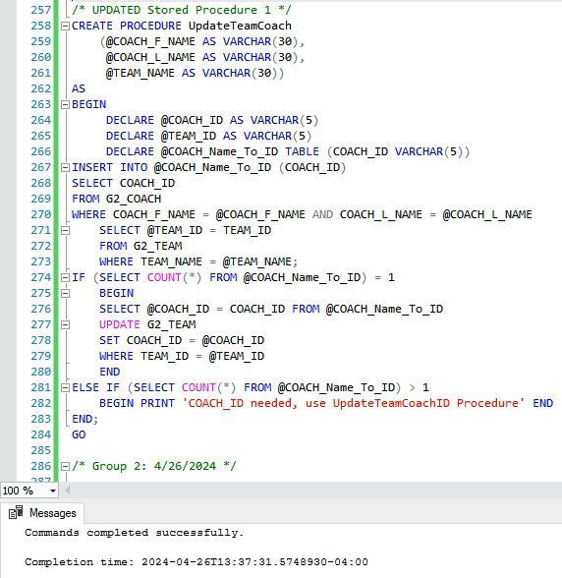
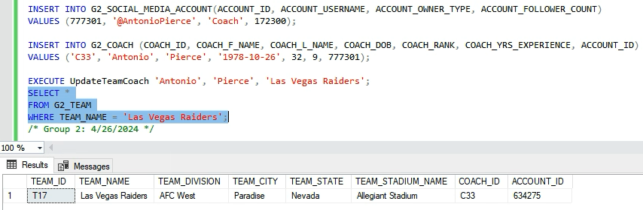
Team Coach Update Procedure
Business Purpose: Maintain accurate and current data to preserve data integrity within a centralized database.
NFL Interest: When a team is performing below expectations it is not uncommon for the coach to be replaced. This stored procedure offers an easy command to update the team’s coach in the team table after a coaching change.
Group 2 - BMSO 601 Term Group Project
12
Notes:
QUERY F- JUSTIN

Slide 13
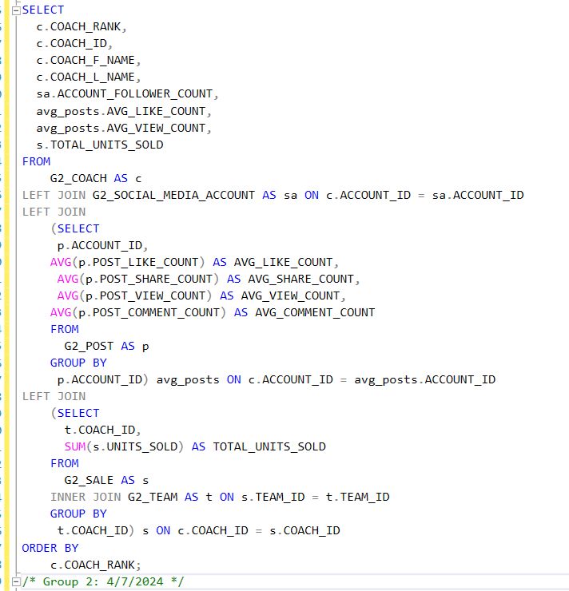
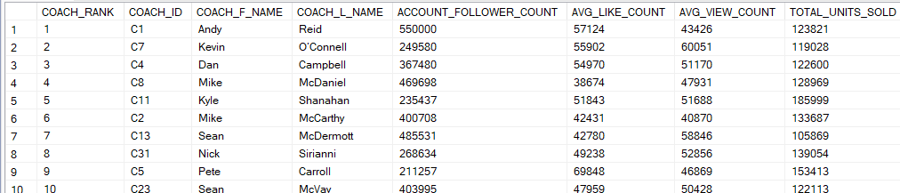
Coach Ranking Impact on Fan Social Engagement and Sales
Business Purpose: To evaluate coach ranking and demographic data to examine how they correlate to fan participation and team sales.
NFL Interest: Does a coach's ranking impact their fan engagement rate on social media?
Group 2 - BMSO 601 Term Group Project
13
Notes:
QUERY D - JUSTIN

Slide 14
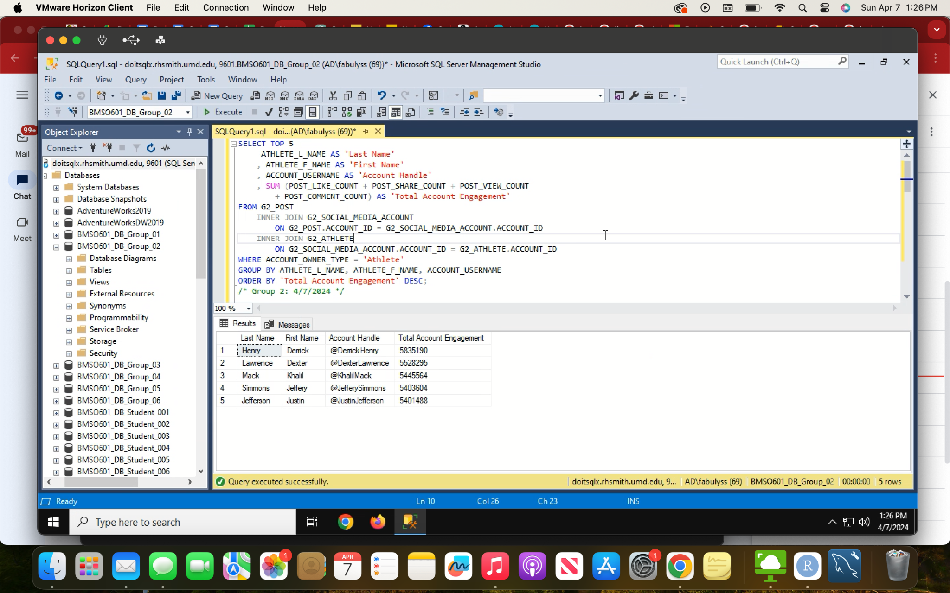
Top Social Media Contributors for Brand Visibility and Sales
Business Purpose: Use social media account data to measure participation via engagement metrics.
NFL Interest: The NFL marketing and social media teams may be able to identify which account holders to leverage for promotion in order to increase merchandise and ticket sales.
Group 2 - BMSO 601 Term Group Project
14
Notes:
QUERY G2- JUSTIN

Slide 15
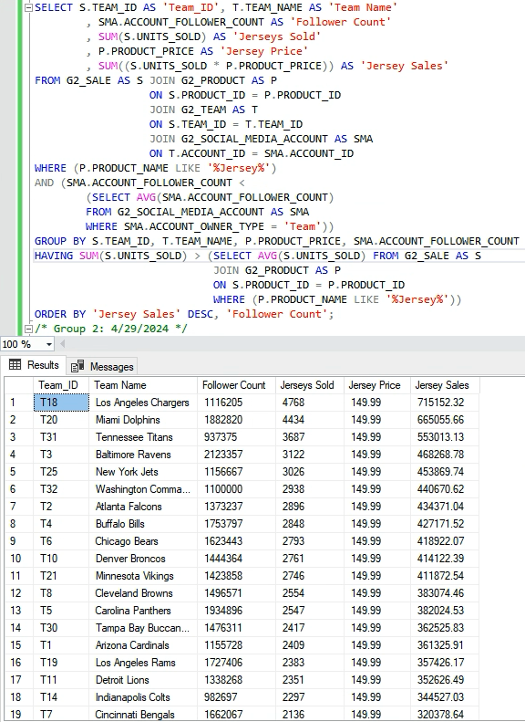
Social Media Impact on Jersey Sales
Business Purpose: Evaluate social media engagements to examine how they correlate to merchandise sales.
NFL Interest: To maximize jersey sales, the NFL would like to uncover if there is any correlation between a team's jersey sales and the number of followers that they have on social media.
Group 2 - BMSO 601 Term Group Project
15
Notes:
QUERY E- SAMARTH (Objective 3) *
Here, we are looking at teams who have follower counts above the league average and jerseys sold above the league average. 12 of 22 teams returned are shown here.
List of teams that have follower counts below the league average and their jersey sales.

Slide 16
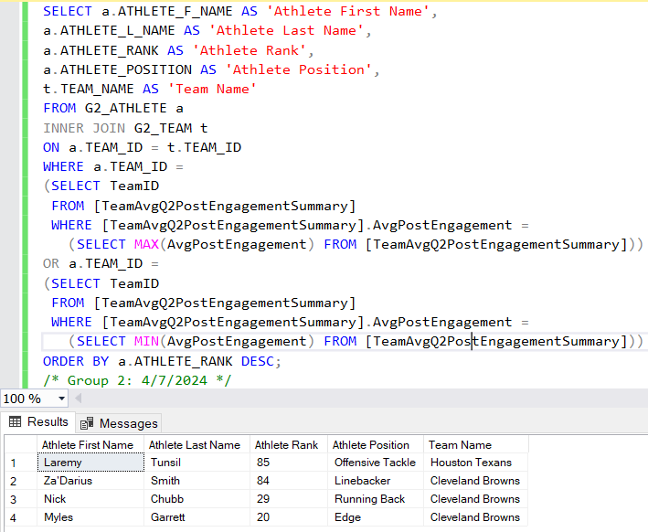
Ranking Athletes on Teams with Highest and Lowest Average Post Engagement
Business Purpose: Evaluate athlete rank and demographic data to examine if both correlate to fan participation and team sales.
NFL Interest: Learn from these athletes/teams so NFL can create marketing strategies that helps other teams athletes boost athlete fan participation and post engagement.
Group 2 - BMSO 601 Term Group Project
18
Notes:
QUERY C- SAMARTH (Objective 5)
Expected Data Output: List of athletes that are in teams with highest and lowest average social media engagement and their individual demographics.

Slide 17
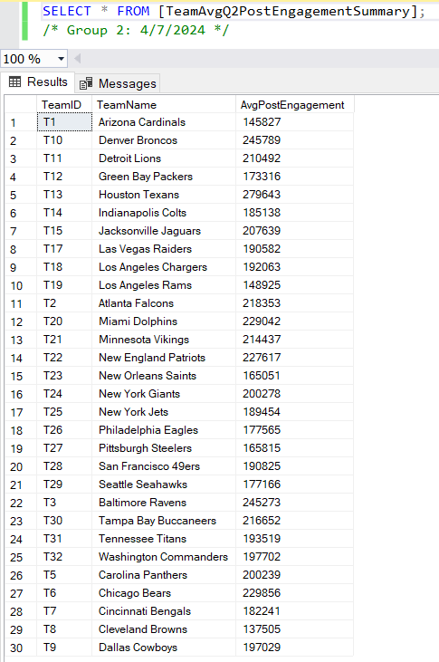
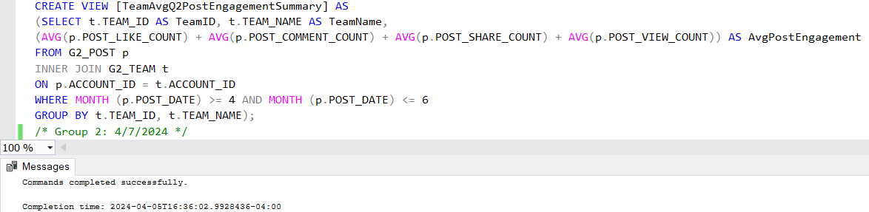
Average Q2 2023 Team Post Engagement Summary View
Business Purpose: Lists the average post engagement of all teams in Q2 2023 in order to create a table that lists the name, rank, position, and team name of athletes.
Group 2 - BMSO 601 Term Group Project
19
Notes:
View - Samarth

Slide 18
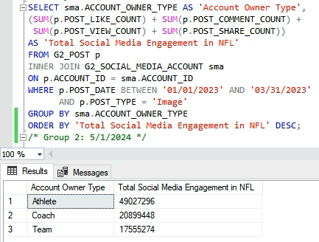
Social Media Engagement per Account Type
Business Purpose: Use social media account data to measure participation via engagement metrics.
NFL Interest: Assess engagement for account owner types to show leadership what groups to prioritize marketing efforts for higher fan participation.
Group 2 - BMSO 601 Term Group Project
16
Notes:
QUERY A- SAMARTH (Objective 1)
Expected Data Output: Table containing the sum of social media post metrics by account type in Q1 2023.
Business Purpose: Creates a table calculating the sum of social media image post metrics (likes, comments, views, shares) by social media account type (coach, athlete, team) in Q1 of 2023 (involves joining the social media account and post tables).
NFL Interest: Assess their league wide social media presence for teams, coaches, and athletes so they can decide which groups to prioritize social media marketing efforts and image content for.
Mission Objective: Objective 1 (Use social media account data to measure participation via engagement metrics).
Expected Data Output: Sum of social media engagement metrics for each account owner type.
Use Case: Shows the NFL leadership what account owner types (teams, coaches, or athletes) should invest more time in their accounts in order to increase fan participation.

Slide 19
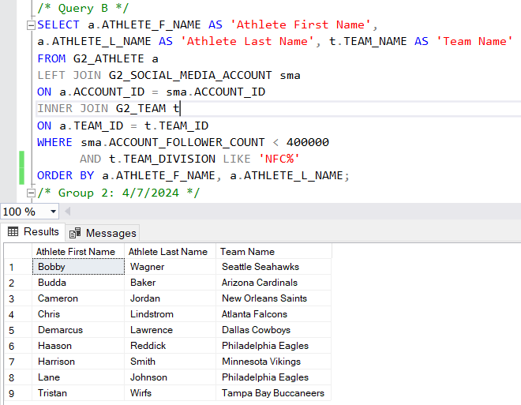
Identifying Athletes with Low Follower Counts
Business Purpose: Monitor follower and engagement metrics of football athletes and teams on social media accounts to identify marketing opportunities.
NFL Interest: Identify athletes from NFC with limited social media presence so their marketing department can prioritize working with them to increase fan participation.
Group 2 - BMSO 601 Term Group Project
17
Notes:
QUERY B- SAMARTH (Objective 4)
Expected Data Output: List of all athletes that have lower social media participation and their associated teams.
Opportunity for the client would be to boost social media presence of athletes with traditionally low follower counts.

Slide 20


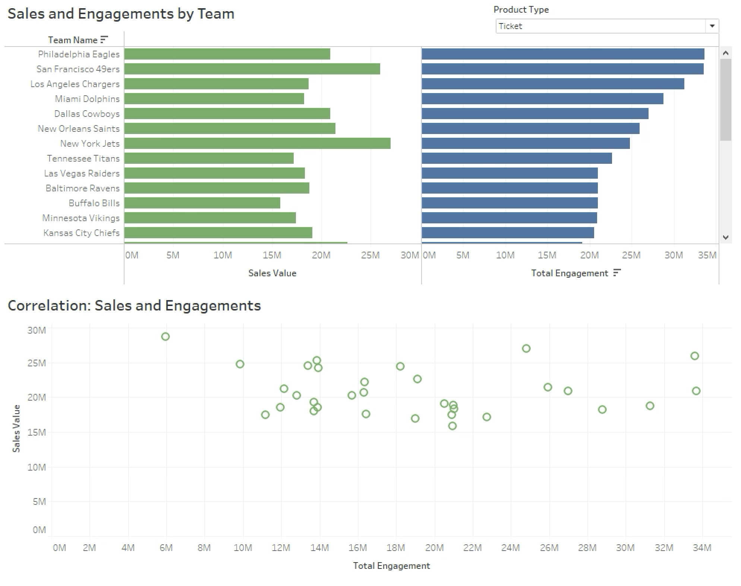

Total Engagements and Ticket Sales
Analyze how ticket sales are related to social media engagements
Total Engagements* are filtered highest to lowest
We see no correlation between the two, indicating that social media presence is not influencing in game attendance.
Group 2 - BMSO 601 Term Group Project
20
* Coach, athlete, and team accounts are rolled up to organizational level for Total Engagements
Notes:
ALYSSA- 30 SEC

Slide 21
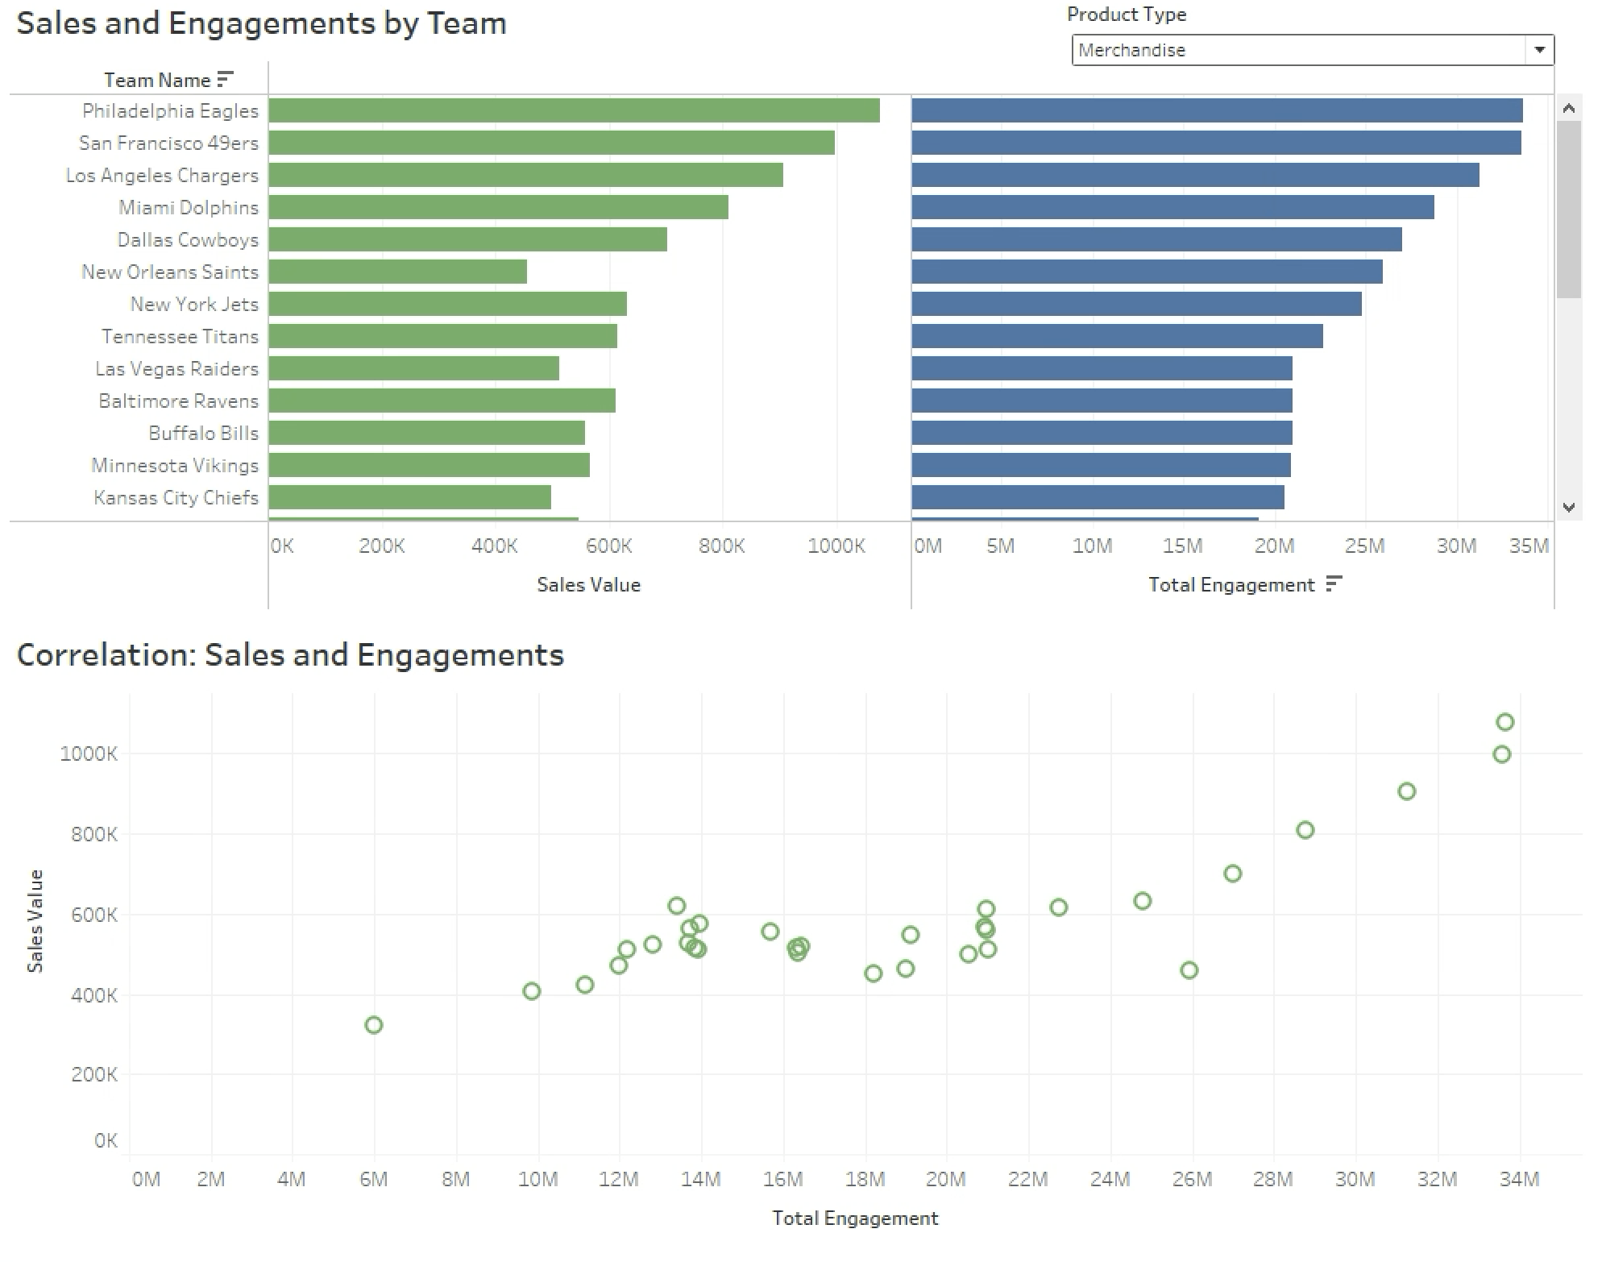
Total Engagements and Merchandise Sales
Analyze how merchandise sales are related to social media engagements.
Total Engagements* are filtered highest to lowest
Positive correlation implies that merchandise sales can be directly influenced by social media engagement.
This will be the focus of our suggested marketing strategy.
Group 2 - BMSO 601 Term Group Project
21
* Coach, athlete, and team accounts are rolled up to organizational level for Total Engagements
Notes:
ALYSSA- 30 SEC

Slide 22
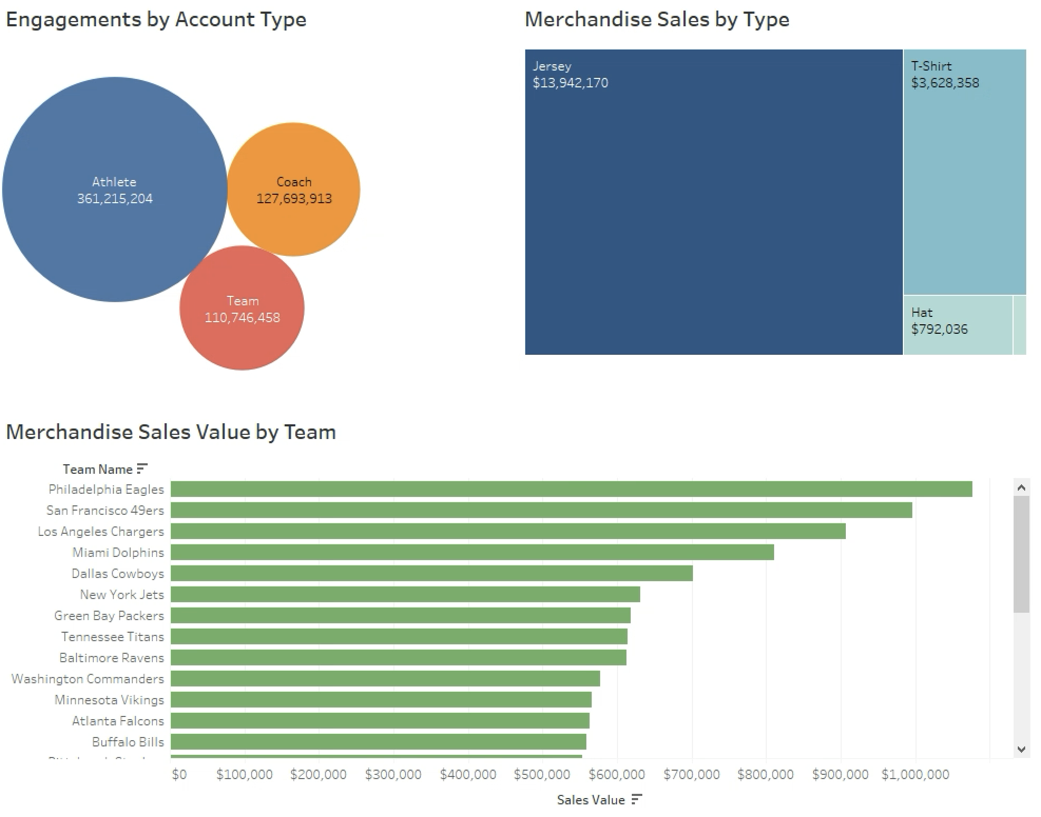
Account Type and Merchandise Sales: Total NFL
An unfiltered look at the league suggests that the majority of engagements are generated by the athlete’s social media accounts.
Jersey sales make up the majority of sales value.
Group 2 - BMSO 601 Term Group Project
22
Notes:
PEARSON- 30 SEC

Slide 23
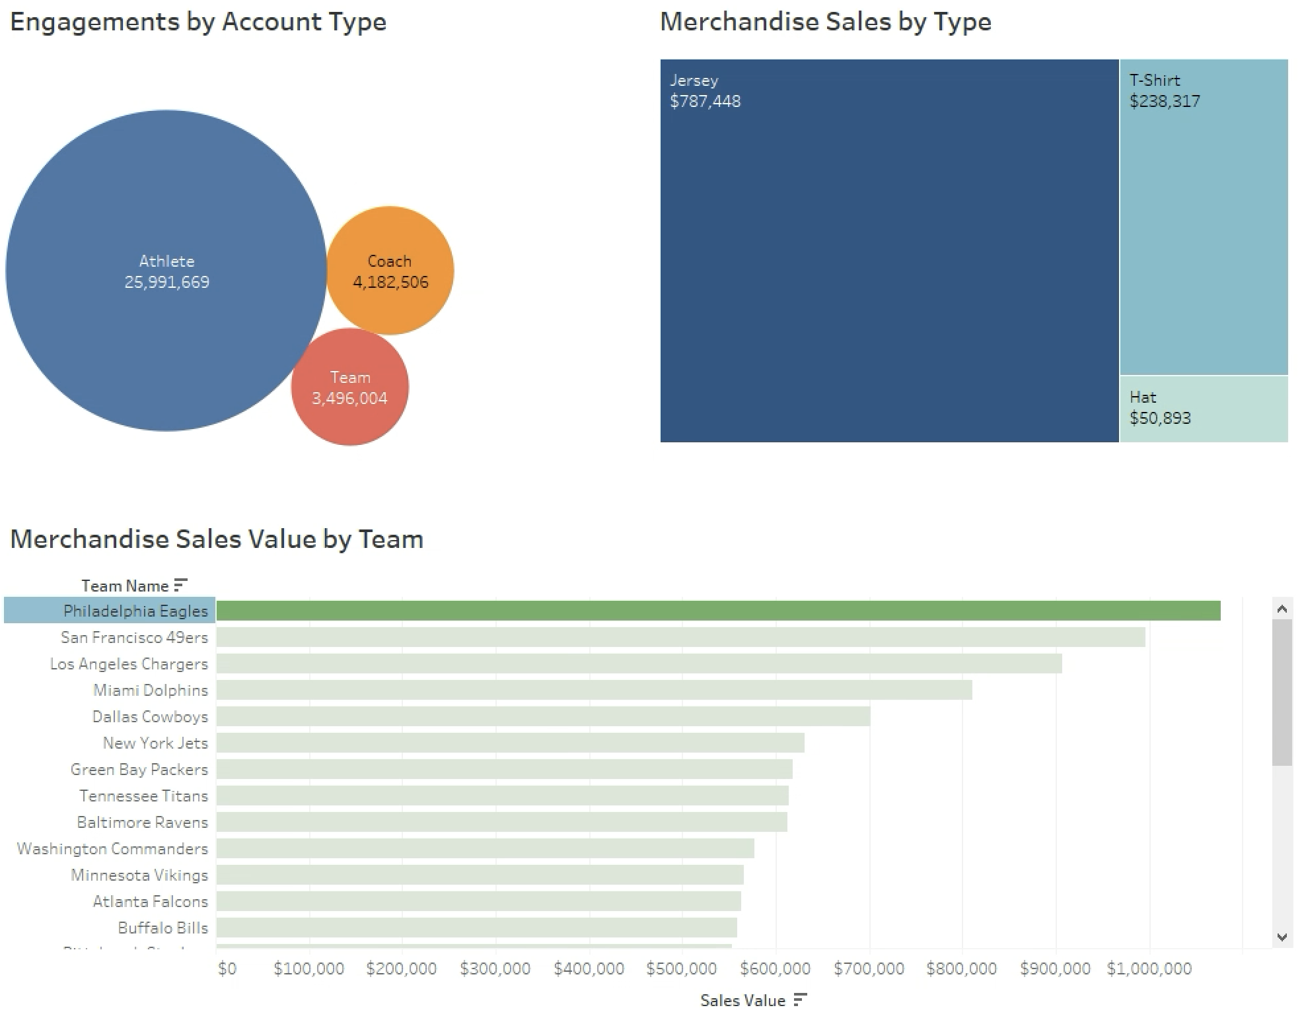
Account Type and Merchandise Sales: Top Sales
Data is filtered on the Philadelphia Eagles, who have the highest merchandise sales and engagements in the league.
Vast majority of social media engagements are coming from their athletes.
Jerseys account for vast majority of merchandise sales.
Group 2 - BMSO 601 Term Group Project
23
Notes:
PEARSON- 30 SEC

Slide 24
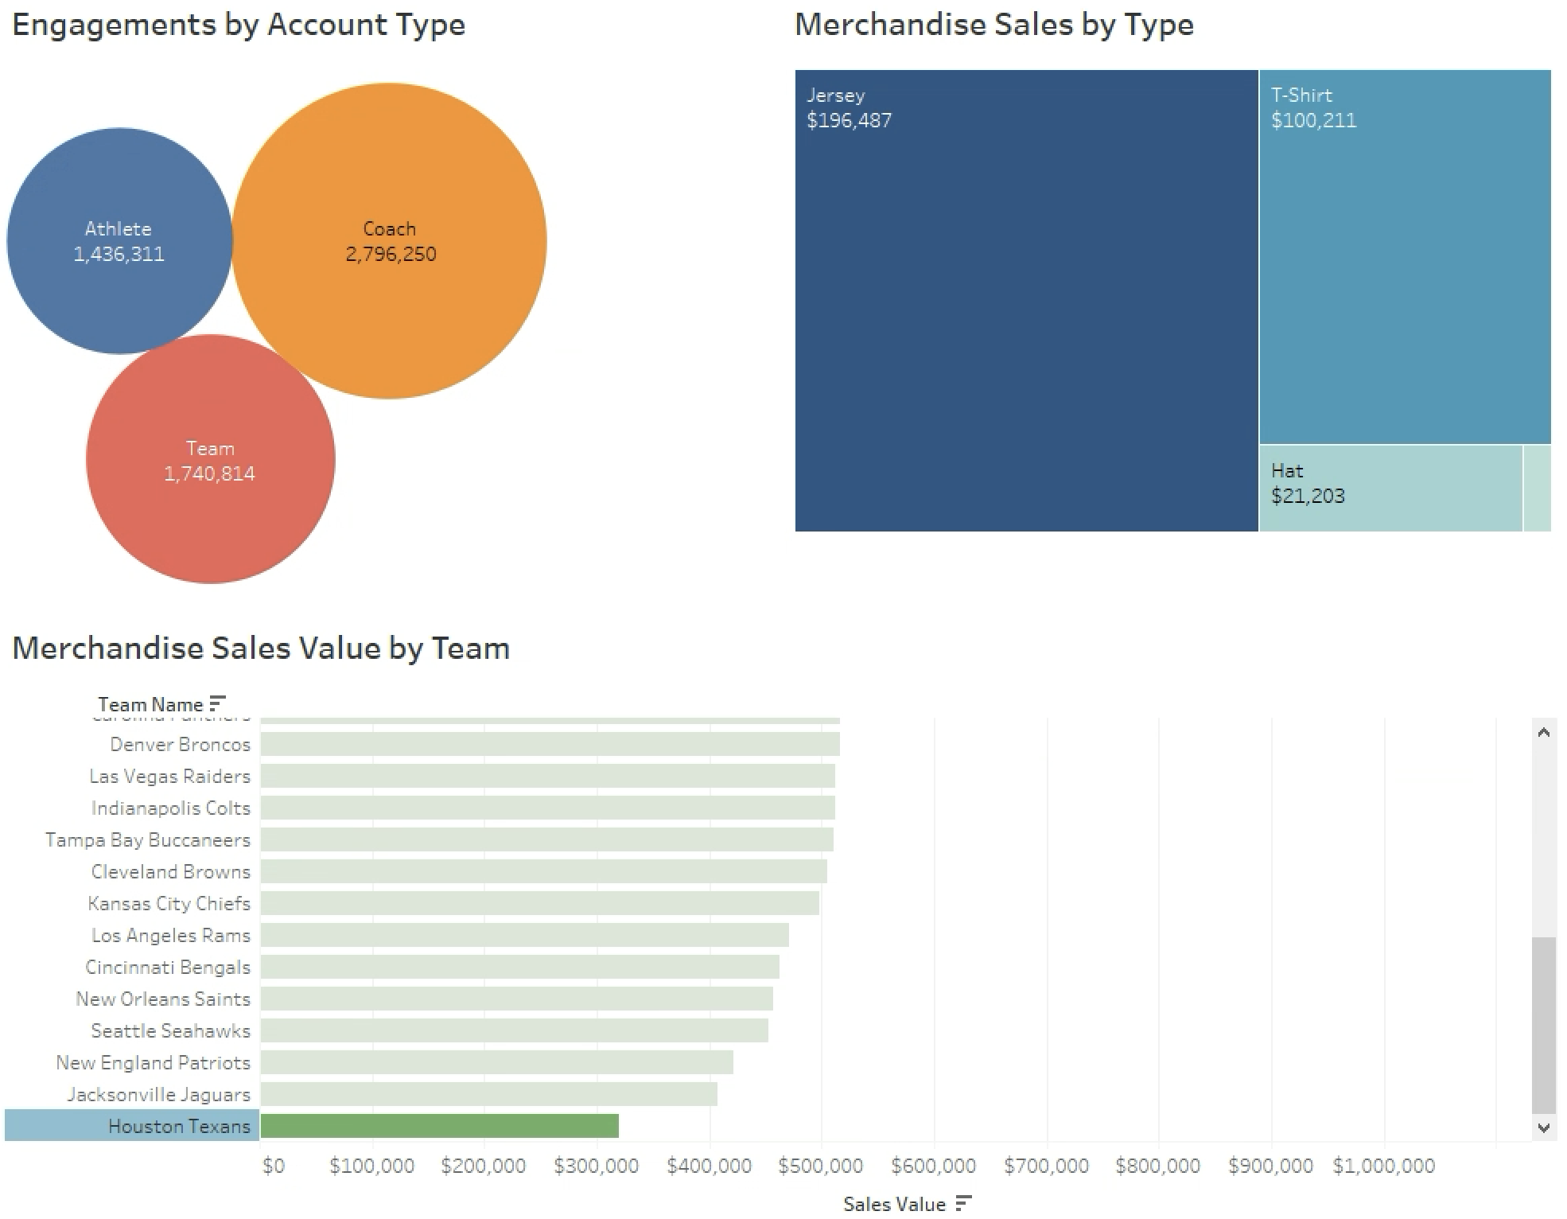
Account Type and Merchandise Sales: Bottom Sales
Data is filtered on the Houston Texans, who have the lowest merchandise sales and engagements in the league.
Majority of engagements are coming from their coaches.
Jerseys account for majority of sales, but proportion is lower than higher performing teams.
Suggest prioritizing athlete social media engagements to drive merchandise sales.
Group 2 - BMSO 601 Term Group Project
24
Notes:
PEARSON- 30 SEC

Slide 25
Next Steps
Perform discovery sessions with NFL marketing leaders to determine if current MVP database meets their business requirements
Find opportunities to boost product sales through social media campaigns
Deep dive into opportunities in targeting different demographics
Perform A/B testing with a sample of teams, coaches, and athletes to understand gains, pains, and areas of improvement for our database user experience
Group 2 - BMSO 601 Term Group Project
25
Notes:
PEARSON

Slide 26
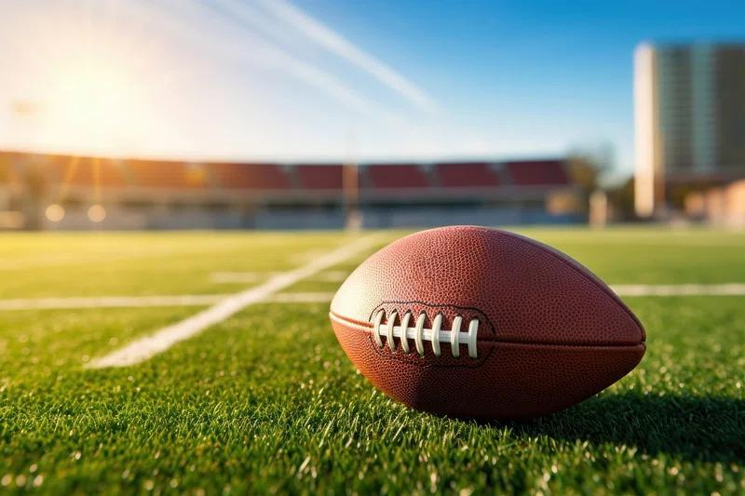
Questions?
We pledge on our honor that we have not given or received any unauthorized assistance.
Signed by: Diana Kim, Justin Mejia, Alyssa Miller, Pearson Roberts, Matthew Rutigliano, and Samarth Tuli
Group 2 - BMSO 601 Term Group Project
26
Notes:
Pearson - 15 secs

Slide 27
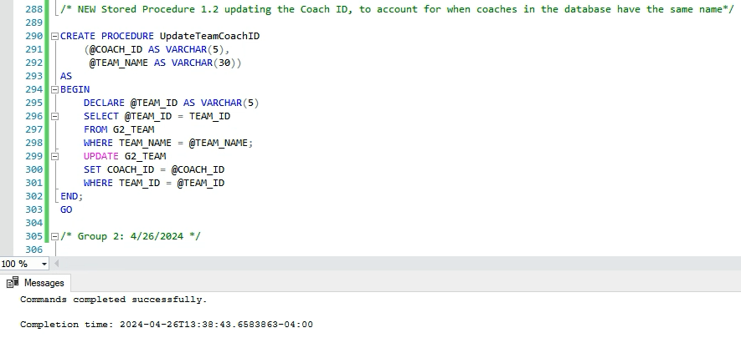
Appendix: Team Coach Update Procedure using Coach_ID
EXECUTE UpdateTeamCoachID 'C33', 'Las Vegas Raiders';;
Group 2 - BMSO 601 Term Group Project
27
Notes:
QUERY F- JUSTIN, to reference if needed

